Slide 1
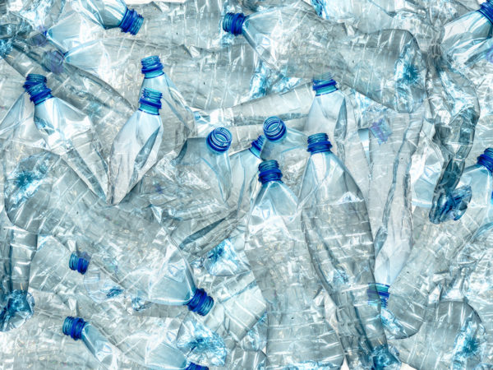
Introduction to Plastic
Notes:
Picture Credits (all used with “creative commons licenses” under advanced Google Search):

Slide 2
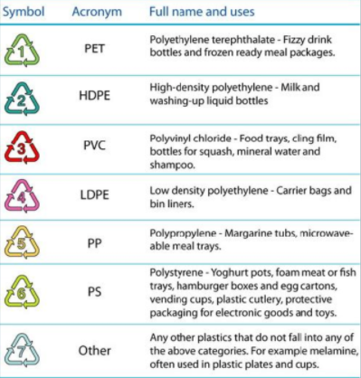
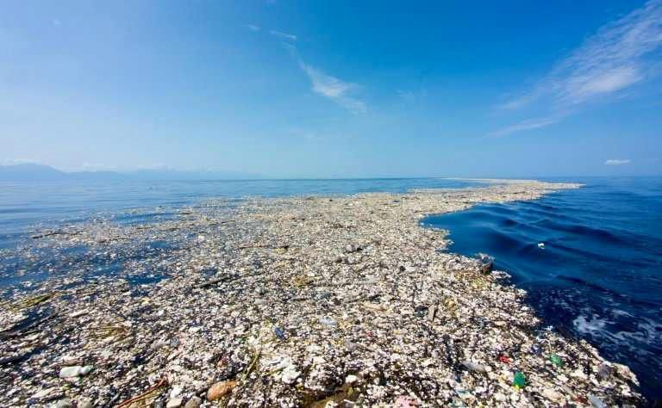
What is plastic?
Notes:
Cheap and versatile!
There are many different forms
Man-made materials
Repeated units of smaller molecules→ monomers
Most made from fossil fuels
Little natural biodegradation
Leads to plastic accumulation!
Picture Credits (all used with “creative commons licenses” under advanced Google Search):

Slide 3
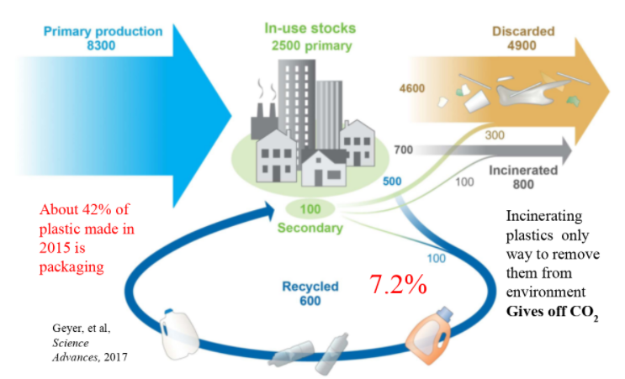
Overall global plastic usage estimate (in million metric tons), 1950-2015
Notes:
Picture Credits (all used with “creative commons licenses” under advanced Google Search):

Slide 4
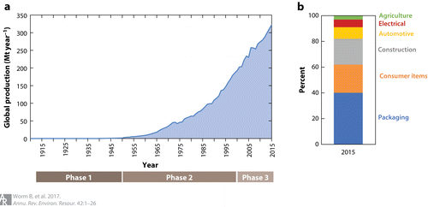
How much plastic exactly?
Notes:
We produce over 350 million tons of plastic per year globally! (Our World Data, 2015)
50% of this is single-use plastic
Over 8 million tons are dumped in the ocean every year (Ederer, Sluka 2020)
Picture Credits (all used with “creative commons licenses” under advanced Google Search):

Slide 5
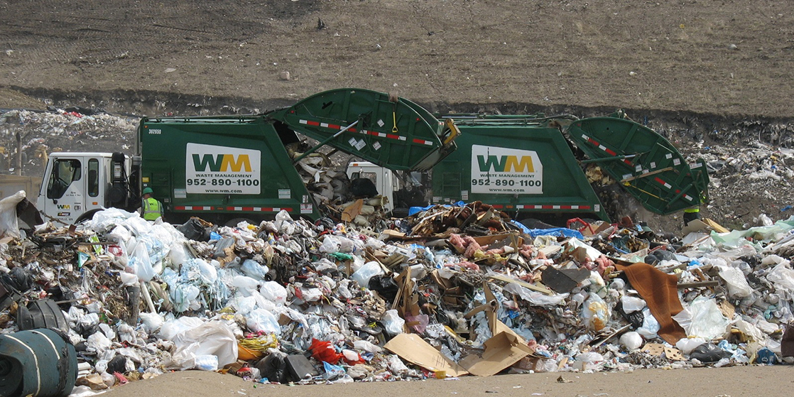
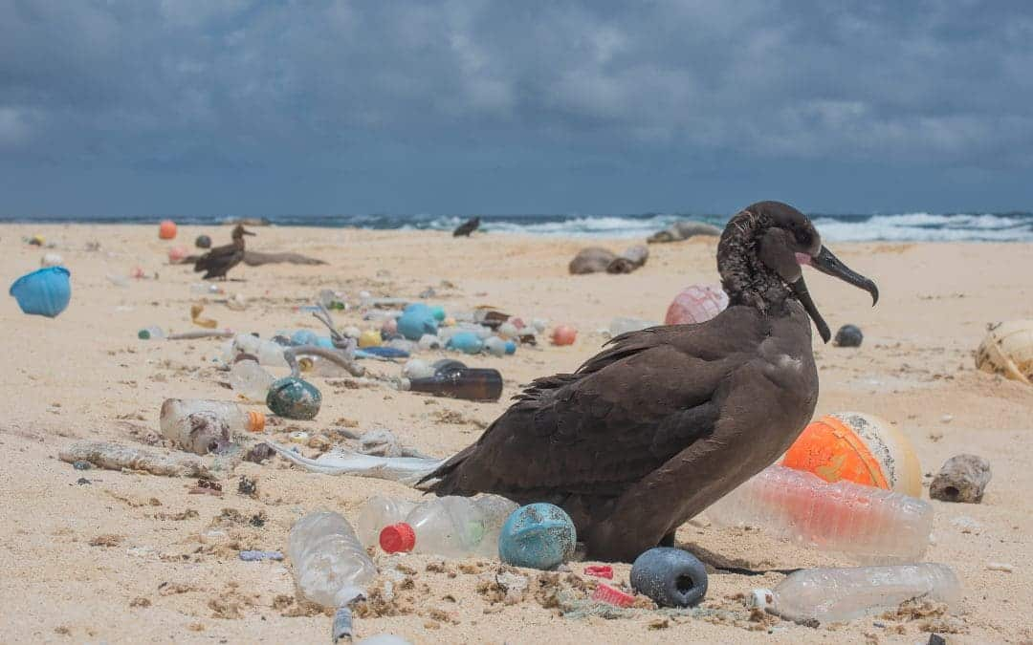
Where does plastic go?
Notes:
Plastic is on the earth for several hundred years at least
Some get stored in landfills
Methane is produced in these oxygen depleted environments
Most end up in the ocean
Plastic of marine origin (fishing nets, cages, rope…)
Plastic not properly disposed of
Wind and rain pushes pollution into waterways which feeds into the ocean
Picture Credits (all used with “creative commons licenses” under advanced Google Search):
Bird surrounded by plastic: Matthew Chauvin @ https://oneworldfamily.de/en/the-ocean-clean-up-new-technology-to-rid-our-oceans-of-plastic-pollution/
Plastic in landfill: OpenStax Chemistry @ https://commons.wikimedia.org/wiki/File:Figure_41_00_01.jpg

Slide 6
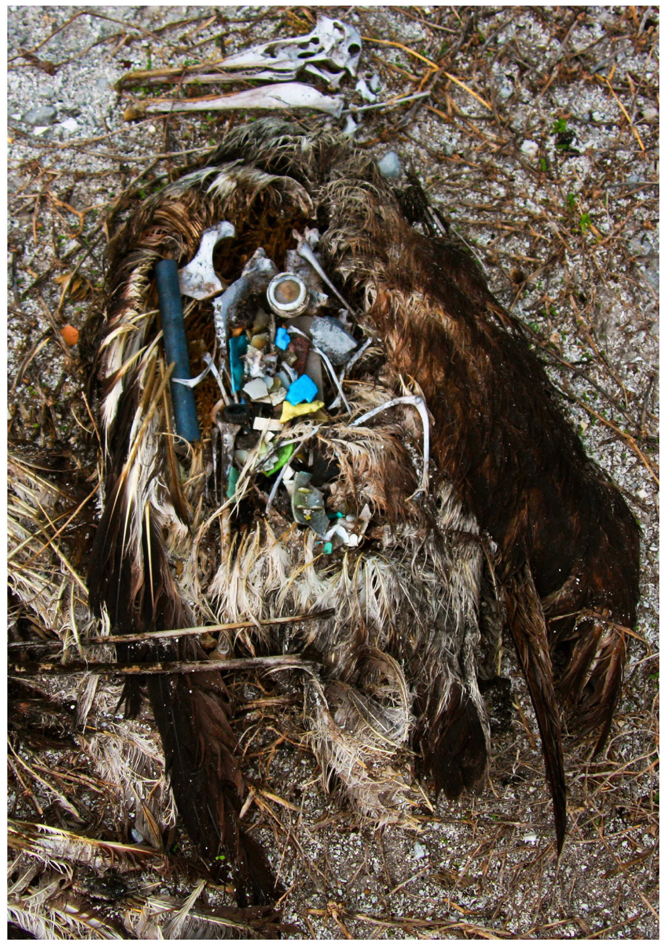
Why is it a problem?
Animal Ingestion
Notes:
Ingestion- Algae attaches itself onto plastic, releases a chemical (dimethyl sulfide) which birds can smell and eat
found in 60% of seabirds and 100% of sea turtles (2018, Ocean Conservancy)
Obstruct intestines
Limits the amount of food the animal can eat
Picture Credits (all used with “creative commons licenses” under advanced Google Search):
Plastic in bird: Lindsay Young @ https://journals.plos.org/plosone/article/figure?id=10.1371/journal.pone.0007623.g002

Slide 7
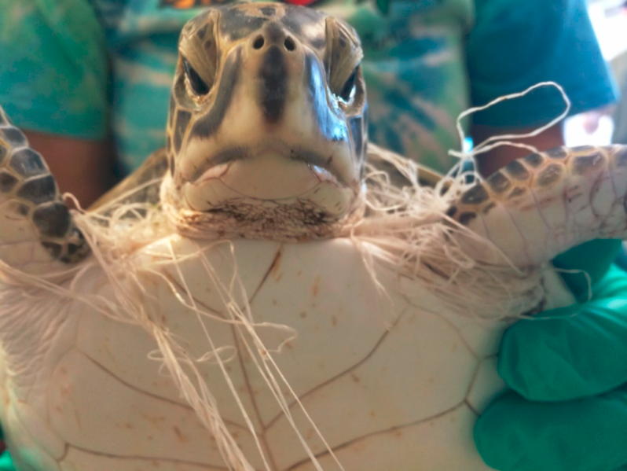
Why is it a problem?
Entanglement
Notes:
Animals may drown, starve, or gain serious infections (fisheries.noaa.gov)
1 in 3 species of marine animals have been found entangled in marine litter (plasticoceans.org)
Picture Credits (all used with “creative commons licenses” under advanced Google Search): https://marinedebris.noaa.gov/multimedia/photos/impacts#prettyPhoto

Slide 8
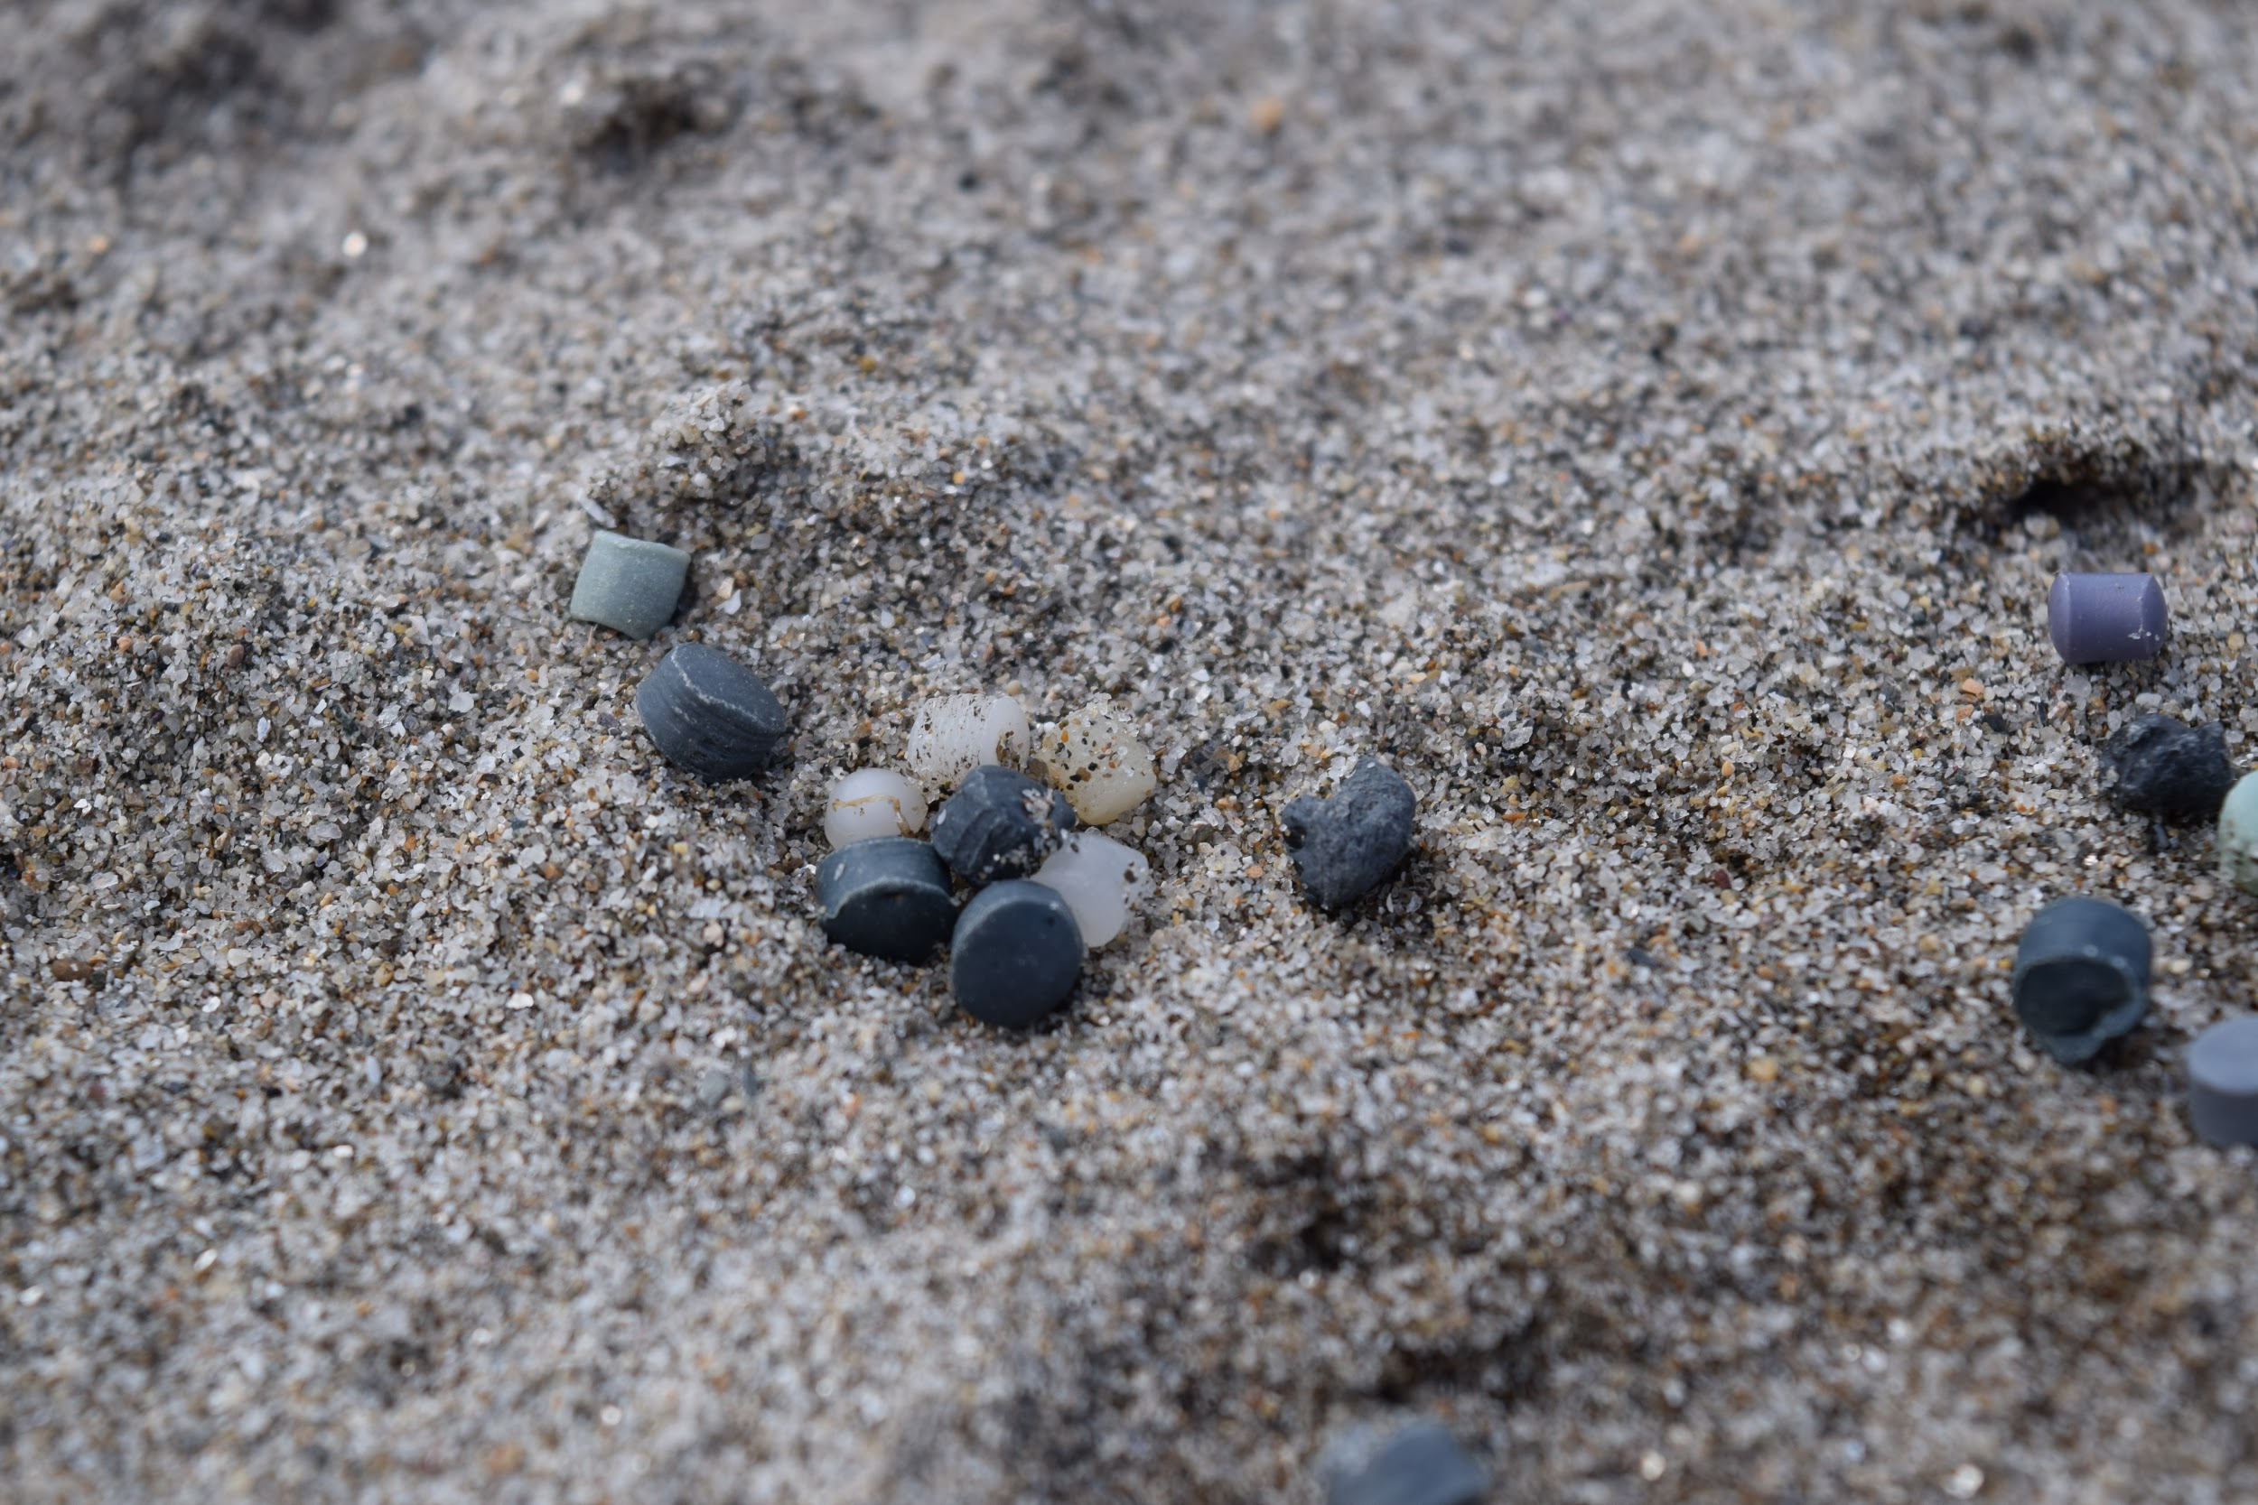
Why is it a problem?
Toxicity
Notes:
Plastic pieces absorb and give off toxins
Disease causing microorganisms attach themselves to plastic
Picture Credit: Sarah Sluka

Slide 9
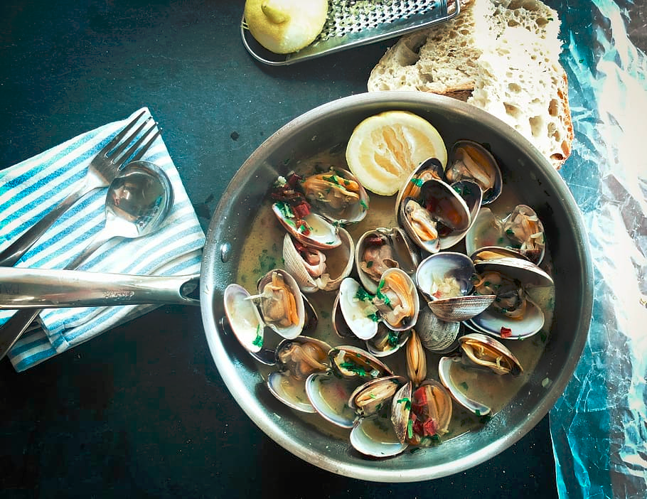
Why is it a problem?
Human Ingestion
Notes:
Human ingestion of microplastics in seafood and water may affect human health
In our drinking water, soil, and air
European seafood consumers will eat 11,000 microplastic items per year (Cauwenberghe, Janssen)
More research needs to be done in this area
Picture Credits (all used with “creative commons licenses” under advanced Google Search): https://www.piqsels.com/en/public-domain-photo-zxwxs

Slide 10
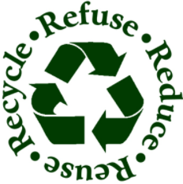
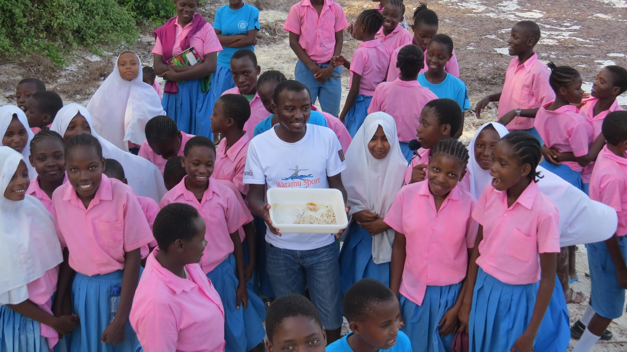
How can you help?
Notes:
Switch to reusable straws, bags, water bottles…
Know the proper way to recycle
Encourage local businesses and government to make big switches in plastic materials
Buy recycled items
Use A Rocha’s Plastic Toolbox to learn more and even participate in community science
Picture Credit: A Rocha Kenya

Slide 11

Plastics Toolbox - www.arocha.org/plastics-toolbox

